Slide 1
50.003: Elements of Software Construction
Week 12
Performance

Slide 2
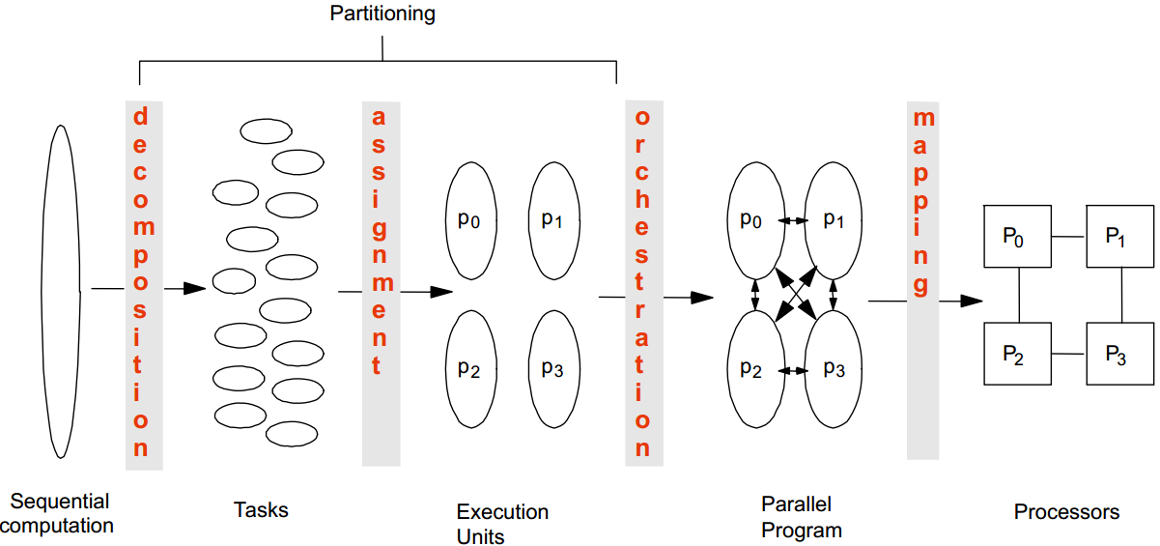
Common Steps to Parallelization

Slide 3
Decomposition
Break up the computation into “self-contained” tasks to be divided among processes
Tasks shouldn’t be too small or too big
Too small: the ratio of useful work vs overhead becomes small
Too big: Number of tasks available at a time is upper bound on achievable speedup
Tasks may become available dynamically

Slide 4
Assignment
Specify mechanism to divide work among cores 
We may want to balance the amount of work for each core
and reduce communication between the threads
Structured approaches usually work well
Code inspection or understanding of application
Apply Well-known design patterns

Slide 5
Orchestration and Mapping
Figure out what kind of communication is needed between each pair of threads
Less communication is better: preserve locality of data
Schedule the threads to satisfy tasks dependences
Use Executor

Slide 6
Example: FactorWebserver
setup and wait for first connection
handlerequest
wait for second connection
handlerequest
wait for third connection
…

Slide 7
Dependency
Bernstein’s Condition
Ri: set of memory locations read (input) by task Ti
Wj: set of memory locations written (output) by task Tj
Two tasks T1 and T2 can run in parallel if input to T1 is not part of output from T2; and input to T2 is not part of output from T1 outputs from T1 and T2 do not overlap.
Example: If T1: a = x+y and T2: b = x+z, then R1 = {x, y}; W1 = {a}; R2 = {x, z}; W2 = {b}
*** assume that x, y and z are different memory locations

Slide 8
Example: FactorWebserver
setup and wait for first connection
handlerequest
wait for second connection
handlerequest
wait for third connection
…

Slide 9
Example: FactorWebserver
calls of handlerequest can run in parallel.
Thread 1
Thread 1
Thread 2
Thread 3
1
1
2
2
3
4
3
5
4
5
…
…

Slide 10
Orchestration Revisited
Given a collection of concurrent tasks, what are important considerations in mapping tasks to units of execution (e.g., threads)?
Magnitude of number of execution units platform will support (less a problem if you use Executor) 
Cost of sharing information among execution units
What if we can only have maximum 4 threads for the server?
Consider parallelizing the Depth-First Search algorithm

Slide 11
Patterns for Parallelization
Provides a cookbook to systematically guide programmers
Decompose, Assign, Orchestrate, Map
Can lead to high quality solutions in some domains
Provide common vocabulary to the programming community
Each pattern has a name, providing a vocabulary for discussing solutions
Helps with software reusability, malleability, and modularity
Written in prescribed format to allow the reader to quickly understand the solution and its context

Slide 12
Patterns for Parallelization
“Patterns for Parallel Programming”, Mattson, Sanders, and Massingill (2005).
The patterns could help you in
Exposing concurrent tasks
Mapping tasks to processes to exploit parallel architecture
Providing supporting code and data structures
Providing low-level mechanisms needed to write parallel programs

Slide 13
Single Program, Multiple Data
All threads/processes run the same program, operating on different data. This model is particularly appropriate for problems with a regular, predictable communication pattern.
MATLAB supports SPMD blocks.
Example: MultiThreadSearch.java (week 5)
Often adopted for GPU programming

Slide 14
Cohort Exercise 1 (10 min)
Given Exercise1.java, apply SPMD (Single Program, Multiple Data) design pattern for concurrent programming to parallelize the program which approximates π by integration.

Slide 15
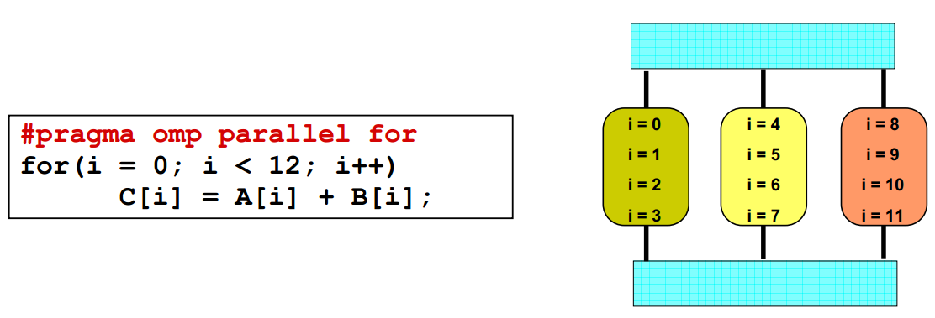
Loop Parallelism Pattern
Given a loop, each thread/process execute part of the loop.
Programming models like OpenMP provide directives to automatically assign loop iteration to execution units

Slide 16
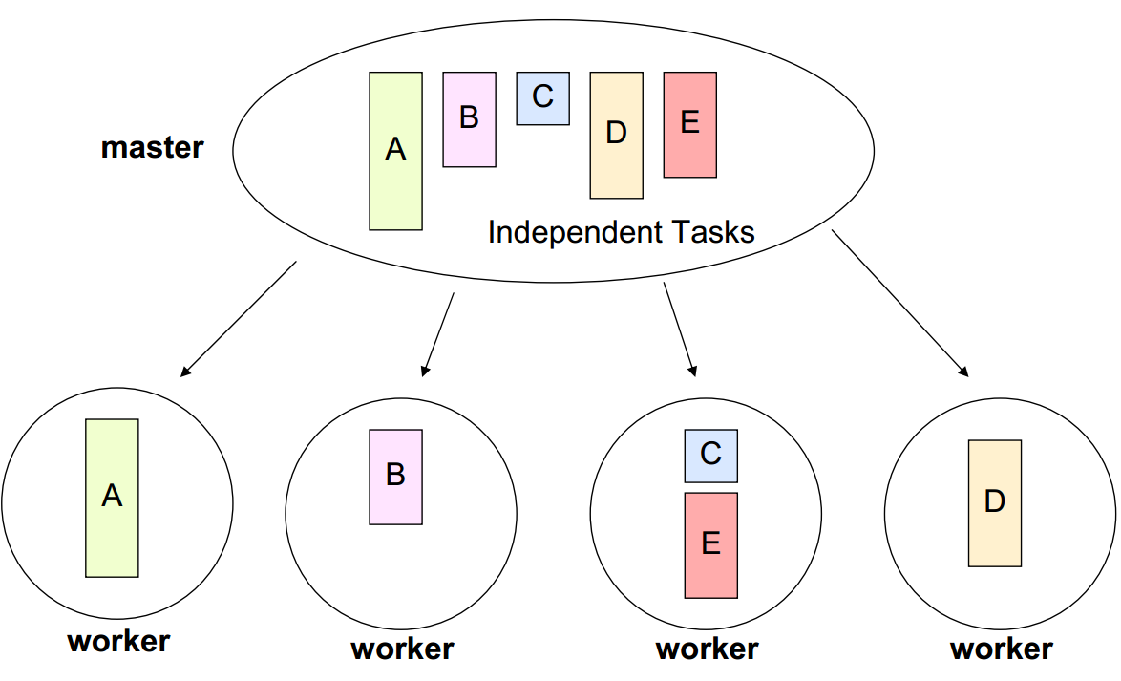
Master/Worker Pattern
A master thread/process divides a problem into several sub-problems and dispatches them to several worker processes.

Slide 17
Fork/Join Pattern
Tasks are created dynamically
Tasks can create more tasks
Manages tasks according to their relationship
Parent task creates new tasks (fork) then waits until they complete (join) before continuing on with the computation

Slide 18
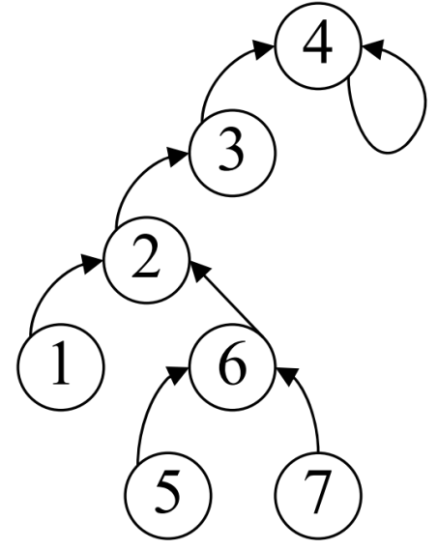
Example: PRAM
How to parallelize BFS?
Start from a root, and visit all the connected nodes in a graph
Nodes closer to the root are visited first
Nodes of the same hop-distance (level) from the root can be visited in parallel

Slide 19
Cohort Exercise 2 (20 min)
Given SlidingGame.java, parallelize it. Hint: ParallelRecursive.java
Click here for a sample program:
ConcurrentSlidingGame.java

Slide 20
Performance vs Complexity
One of the primary reasons to use threads is to improve performance.
Techniques for improving performance also increase complexity and the likelihood of safety and liveness failures.
Avoid premature optimization. First make it right, then make it fast – if
it is not already fast enough.
The quest for performance is probably the single greatest source of
concurrency bugs.

Slide 21
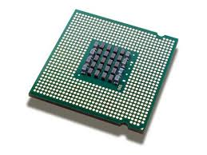



Bottleneck
Your program
Find out what the bottleneck is before you optimize.

Slide 22
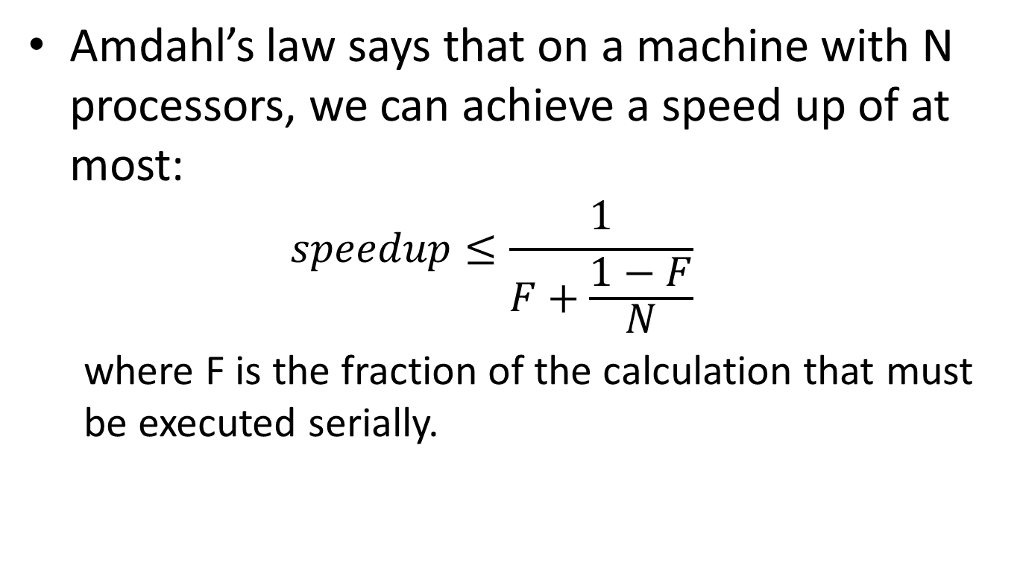
Amdahl’s Law
Amdahl’s law says that on a machine with N processors, we can achieve a speed up of at most:
$$speedup≤\frac{1}{F+\frac{1−F}{N}}$$
where F is the fraction of the calculation that must be executed serially.

Slide 23
Serialization
class Slave extends Thread {
private final BlockingQueue<Runnable> queue;
public Slave (BlockingQueue<Runnable> queue) {
this.queue = queue;
}
public void run() {
while (true) {
try {
Runnable task = queue.poll();
task.run();
}
catch (Exception e) {
break;
}
}
}
}
All Concurrent applications have some sources of serialization

Slide 24
Cohort Exercise 3 (10 min)
Complete the following table to calculate maximum speedup
Given PerformanceExperiment.java, vary the number of the threads and see how much speedup you can get.
N, F | Speedup
10, 10%
100, 10%
∞, 10%
10, 25%
100, 25%
∞, 25%

Slide 25
Cost Introduced by Threads
Context switching: requires saving the execution context of the currently running thread and restoring the execution context of the newly scheduled thread
CPU time spent on JVM/OS
Cache misses
Costs about 5,000 to 10,000 clock cycles
Memory synchronization:
Memory barriers inhibit compiler optimization

Slide 26
Lock/Release Cost
Access to resources guarded by an exclusive lock is serialized – one thread at a time delay may access it
Example: a naïve execution would require and release the lock on the vector four times.
It gets much worse with lock contention.
public String getNames() {
List<String> names = new Vector<String>();
names.add(“Alice”);
names.add(“Bob”);
names.add(“Carl”);
return names.toString();
}

Slide 27
Lock Contention
Two factors influence the likelihood of contention for a lock
How often that lock is requested
How long it is held once acquired
There are three ways to reduce lock contention
Reduce the duration for which locks are held
Reduce the frequency with which locks are requested
Replace exclusive locks with coordination mechanisms that permit greater concurrency

Slide 28
“Get in, get out”
public class ReduceLockScope {
//@GuardedBy("this")
private final Map<String, String> attributes = new HashMap<String, String>();
public synchronized boolean userLocationMatches (String name, String regexp) {
String key = "users." + name + ".location";
String location = attributes.get(key);
if (location == null) {
return false;
}
else {
return Pattern.matches(regexp, location);
}
}
}

Slide 29
“Get in, get out”
public class ReduceLockScope {
//@GuardedBy("this")
private final Map<String, String> attributes = new HashMap<String, String>();
public boolean userLocationMatches (String name, String regexp) {
String key = "users." + name + ".location";
String location;
synchronized (this) {
location = attributes.get(key);
}
if (location == null) {
return false;
}
else {
return Pattern.matches(regexp, location);
}
}
}
The amount of serialized code is reduced!

Slide 30
“Get in, get out”
public class ReduceLockScope {
//@GuardedBy("this")
private final Map<String, String> attributes = new ConcurrentHashMap<String, String>();
public boolean userLocationMatches (String name, String regexp) {
String key = "users." + name + ".location";
String location = attributes.get(key);
if (location == null) {
return false;
}
else {
return Pattern.matches(regexp, location);
}
}
}
Delegating thread safety to ConcurrentHashMap

Slide 31
Reducing Lock Granularity
object
lock
Every thread acquires the lock to
access any locked object

Slide 32
Reducing Lock Granularity
object
lock
Every thread acquires the lock to
access any locked object

Slide 33
Reducing Lock Granularity
lock
object
Lock splitting

Slide 34
Lock Splitting
public class ServerStatus {
@GuardedBy("this") public final Set<String> users;
@GuardedBy("this") public final Set<String> queries;
...
public synchronized void addUser(String u) {
users.add(u);
}
public synchronized void addQuery(String q) {
queries.add(q);
}
public synchronized void removeUser(String u) {
users.remove(u);
}
}

Slide 35
Lock Splitting
public class ServerStatus {
@GuardedBy(“users") public final Set<String> users;
@GuardedBy(“queries") public final Set<String> queries;
...
public void addUser(String u) {
synchronzied (users) { users.add(u); }
}
public void addQuery(String q) {
synchronized (queries) { queries.add(q); }
}
public synchronized void removeUser(String u) {
synchronzied (users) { sers.remove(u); }
}
}

Slide 36
Lock Stripping
Lock splitting can sometimes to extended to partition lock on a variable sized set of independent object, which is called lock stripping.
Example: ConcurrentHashMap, 16 locks

Slide 37
Alternatives to Exclusive Locks
To forego the use of exclusive locks in favor of a more concurrency-friendly means of managing shared state
Read-write locks: more than one reader can access the shared resource concurrently, but writers must acquire the lock exclusively
Immutable objects
Atomic variables

Slide 38
Cohort Exercise 4 (15 min)
Given StripedMap.java, assume that the objects in the buckets are independent. Complete method get(), size() and clear() using the idea of lock stripping.
Click here for a sample program: StripedMapSolution.java

Slide 39
Non-blocking Synchronization
Week 12

Slide 40
Disadvantage of Locking
The ratio of scheduling overhead to useful work can be quite high when the lock is frequently contended – due to context switch and scheduling delays.
A thread with the lock may be delayed (due to a page fault, scheduling delay, etc.).
Locking is simply a heavyweight mechanism for simple operations like count++

Slide 41
Can we get rid of locks?

Slide 42
Reality is Messy
Java Programs
What if we know what are the atomic steps?
Bytecode
What are the atomic steps? For example, how many steps are “i++”?
What are the order of execution? Given “i++; j++; i++”, can we switch the last two statements?
JVM
Physical Machine
Where are the variable values stored? Cache, heap memory, stack memory.

Slide 43
Hardware Support for Concurrency
Processors designed for multiprocessor operation provide special instructions for managing concurrent access to shared variables, for example:
compare-and-swap
load-linked/store-conditional
OSs and JVMs use these instructions to implement locks and concurrent data structures

Slide 44
Compare and Swap
CAS has three operands
a memory location V,
the expected old value A,
and the new value B.
CAS updates V to the new value B, but only if the value in V matches the expected old value A; otherwise, it does nothing. In either case, it returns the value currently in V.
Click here for a sample program: SimulatedCAS.java

Slide 45
A Non-blocking Counter
public class CasCounter {
private SimulatedCAS value;
public int getValue() {
return value.get();
}
public int increment() {
int v;
do {
v = value.get();
} while (v != value.compareAndSwap(v, v + 1));
return v + 1;
}
}
Is it thread-safe?
Is it more efficient than a lock-based counter?
Any potential problem?
CAS is used to implement AtomicXxx in Java

Slide 46
Cohort Exercise 5 (10 min)
Given CasCounterTest.java, design and implement a performance test to compare the CAS-based counter (using AtomicInteger) and lock-based counter

Slide 47
CAS in Java
CAS is supported in atomic variable classes (12 in java.util.concurrent.atomic), which are used, to implement most of the classes in java.util.concurrent
AtomicInteger, AtomicBoolean, AtomicReference, etc.

Slide 48
Non-blocking Algorithms
An algorithm is called non-blocking if failure or suspension of any thread cannot cause failure or suspension of another thread;
Non-blocking algorithms are immune to deadlock (though, in unlikely scenarios, may exhibit livelock or starvation)
Non-blocking algorithms are known for
Stacks (Treiber’s), queues, hash tables, etc.

Slide 49
Example 1: Atomic Range
Click here for a sample program: CasNumberRange.java

Slide 50
Example 2: Non-blocking Stack
Considerably more complicated than their lock-based equivalent
The key is figuring out how to limit the scope of atomic changes to a single variable
Click here for a sample program: ConcurrentStack.java

Slide 51
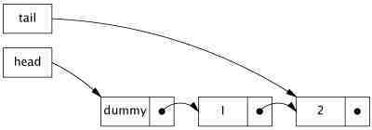
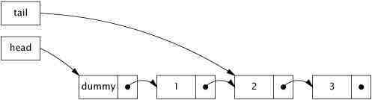
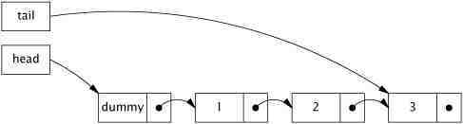
Example 3: Non-blocking Linked List
It is called Michael-Scott non-blocking linked-queue algorithm
Queue insertion:

Slide 52
Example 3: Non-blocking Linked List
normal state
Intermediate state
normal state
Observation: if the queue is in the normal state, tail.next is null.
Click here for a sample program: LinkedQueue.java

Slide 53
How do we prove that the algorithm is correct?

Slide 54
while (true) {
1. Node<E> curTail = tail.get();
2. Node<E> tailNext = curTail.next.get();
3. if (curTail == tail.get()) {
4. if (tailNext != null) {
5. tail.compareAndSet(curTail, tailNext);
6. } else {
7. if (curTail.next.compareAndSet(null, newNode)) {
8. tail.compareAndSet(curTail, newNode);
9. return true;
0. }
}
}
}
1
2
3
4
5
6
7
8
9
0

Slide 55
Thread 1
Thread 2
1
1
2
2
3
3
4
4
5
5
6
6
7
7
8
8
9
9
0
0

Slide 56
Cohort Exercise 6
The ABA problem: A CAS effectively asks “Is the value of V still A?” and proceeds with the update if so. What if we really want to ask “Has the value of V changed since I last observed it to be A”. Modify NonblockingCounter.java to full-fill the requirement.
Hint: use AtomicStampedReference to help.

Slide 57
Summary
Atomic variables and non-blocking algorithms are the best
It is a lot trickier to design non-blocking algorithms – if you do, you might have an algorithm named after you!

Slide 58

Software Engineering
User Requirements
The species we called programmers
System Implementation

Slide 59

Software Engineering
User Requirements
the magical programming machine
System Implementation
***The synthesis problem (i.e., synthesizing a program from a specification automatically) is undecidable (i.e., there doesn’t exist an algorithm which could solve the problem in finite time).

